Slide 1
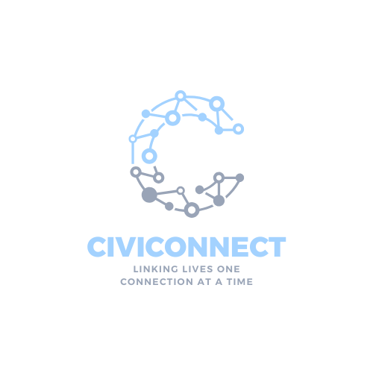
iviConnect
Linking Lives, One Connection At a Time

Slide 2
The Problem
Millions lack reliable internet, particularly during natural disasters and in rural areas.
Existing solutions like satellite and cellular networks are often costly or fail in remote, crisis settings.
Disconnected communities lack access to essential resources, healthcare, and education.

Slide 3
CiviConnect
Our mesh network solution is about 90% more affordable than traditional cellular networks and 70% cheaper than satellite, yet it’s 50% more resilient.
Mesh Network:
Scalable, decentralized coverage.
Solar-Powered Nodes:
50 %
>$300
Reliable, off-grid connectivity.
More resilient
Per Node
VoIP and Data Access:
Enables community calls and critical information access.
90% Affordable
(than traditional cellular network)
70% Cheaper
(than satellite)

Slide 4
 | CiviConnect (Mesh Network) | Cellular Networks (4G & 5G) | Satellite Internet (Eg. StarLink) | Wi-Fi Extenders and Routers
Self-Healing & Resilient
Self Sustaining (Solar Power compatible)
Low setup & Maintenance cost
Community Training & Empowerment

Slide 5
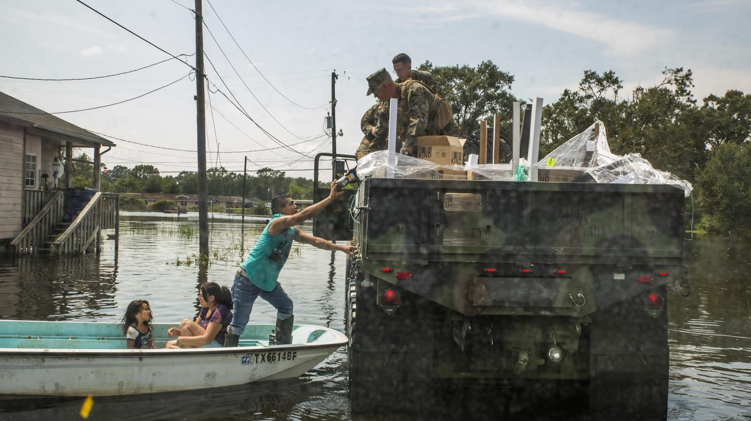
Hurricane Helene:
>90%
Of networks down
Hurricane Katrina:
>60%
Of networks down
In a disaster, anyone can become undeserved

Slide 6
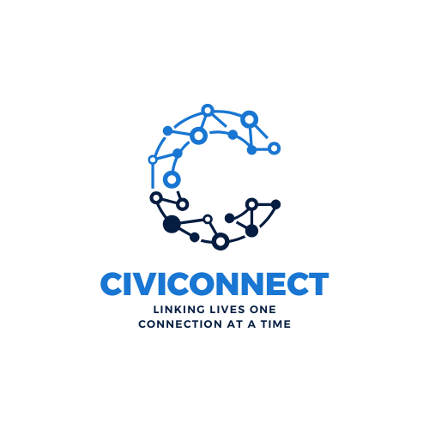
Rural Areas
Education
Healthcare
Community Outreach

Slide 7
Impact and Opportunity
Economic & Social Benefits:
Scalability:
Investor Potential:
Emergency communications, healthcare, and resource access.
Network can be increased and decreased according to region size.
Low-cost, sustainable infrastructure with high impact potential.

Slide 8
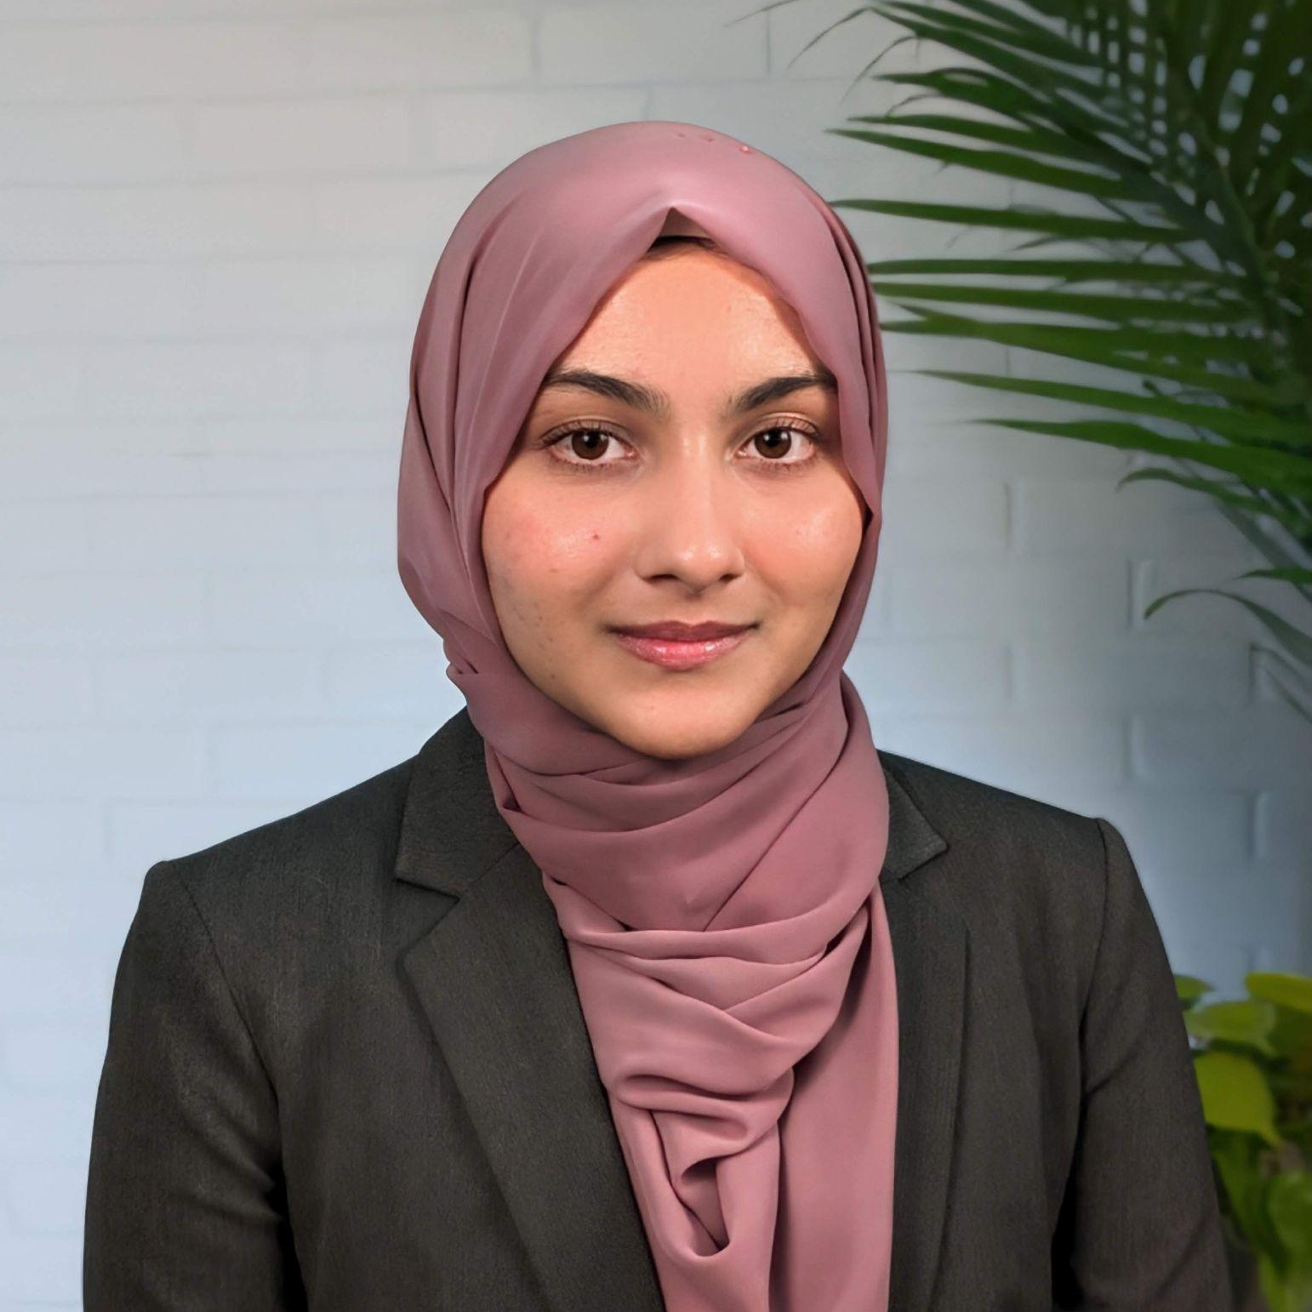
Team Members
01
03
02
Qanita Baqibillah
Imaadudeen Allaudeen
Kaoru Seki
B.S. in Computer Science UMBC 25’
B.Tech in Mechatronics HITS ’23
M.S in Engineering Management UMBC ‘25
B.A. in Business Technology Administration UMBC 24’
M.S. in Human-Centered Computing UMBC 25’

